Slide 1
DUAL North America Private & Excess Flood WebRater

Slide 2
Corporate Overview: DUAL North America
Howden Group Holdings is comprised of two broking entities: Howden and RKH Specialty, and an underwriting entity: The DUAL Group.
DUAL has 3 divisions: Asia PAC, Europe/UK, and North America, and is the largest international MGA and Lloyd’s largest international coverholder.
DUAL North America is a leading Specialty Program Administrator offering specialized property and casualty products.
Howden Group Holdings
DUAL Group
12 specialized programs
DUAL North America
2021 GWP of $500M+
150 team members
10 U.S. office locations

Slide 3
Specialized Programs & Entities
DUAL North America
Primary & Excess Flood
Specialty Perils
E&S Property
Professional Liability
Environmental Liability
Contractors Liability
Cyber
Energy/Marine
Management Liability
DUAL Logistics
Products Liability
Transactional Risk & Excess D & O

Slide 4
Fewer Keystrokes and Higher Hit Ratios
Flood WebRater
The new Flood WebRater is easier to use, requires fewer keystrokes, and offers higher hit ratios with multiple underwriting program options.
DUAL's new Flood WebRater is a completely redesigned system that:
Has a new look and feel.
Has a simpler user interface.
Improves security.
Includes an additional Lloyd’s of London underwriting program.
Improves location eligibility and quote options.
Will be updated with new features and self-servicing capabilities in the months ahead.

Slide 5
Features
Flood WebRater
Options to quote standalone Primary or Excess Flood
Instant and bindable premium quotation
E-signature
Surplus lines and tax filing capabilities
Online payment options through ePay Policy
Choice-driven model for underwriting programs offering primary flood limits up to $5 Million and additional excess flood limits up to $45 Million
Different underwriting programs will have different underwriting appetites, increasing property location eligibility estimated at 25%

Slide 6
Advantages of Private Flood
The DUAL Private Flood Policy has some distinct advantages over the traditional NFIP policy:
— A.M. Best A rated carriers
— Deductibles as low as $1,000
— Nationwide – Non-Admitted coverage
— Competitive rates against the renewing NFIP policy
— Higher Building & Contents Limits Available
— Replacement cost loss adjustment
— Business interruption/loss of rents
— Additional living expense
— No elevation certificate needed on certain risks
— Basement coverage available on certain risks
— Lender acceptance of policy wording
— The ability to schedule multiple locations in one policy
— Manual review of properties with negative elevations
— Excess flood with blanket coverage over program sub-limits.

Slide 7
Get Setup on the New System
www.privatefloodcoverage.com
Log into your DUAL Wholesale Portal. As a reminder, your username is your email address. If you forget your password, you can reset it by clicking Forgot Password on the login screen.
Migrate Account
Follow the steps at the bottom of the Manage screen to migrate your Wholesale Portal account to the new Flood WebRater.
You can use the current Online Rater and the new Flood WebRater at the same time. You can get familiar with and transition your team and agents over to the new WebRater when you are ready.

Slide 8
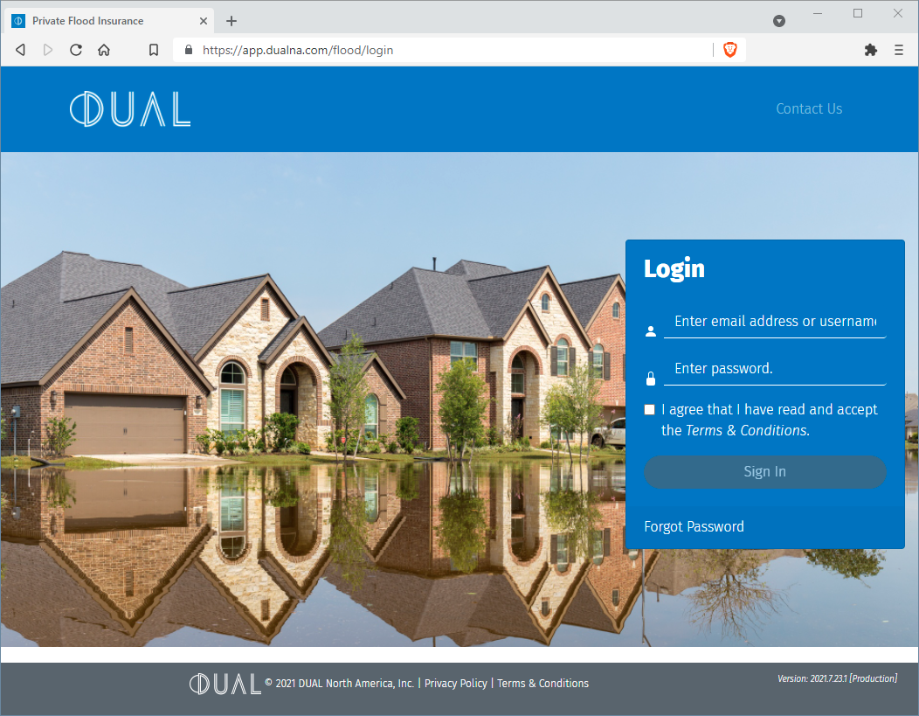
DEMO
It is undoubtedly an exciting and turbulent time in the flood insurance market. At DUAL, we are committed to providing our partners with the best service and information throughout the market changes. The new enhancements to the online rating platform will allow us to provide our brokers easier and more comprehensive access to flood insurance options than ever before. – Patrick Small, President of DUAL Specialty Flood

Slide 9
Contact Our Team
Thomas Becker
Director of Business Development
Patrick Small
President of DUAL Specialty Flood
Teri Lawson
Director of Underwriting
Michael Culbert
AVP Underwriting
973.631.7575 X 161
tbecker@ dualcommercial.com
973.631.7575 X 160
psmall@ dualcommercial.com
973.631.7575 X 162
tlawson@ dualcommercial.com
973.631.7575 X 608
mculbert@ dualcommercial.com

