Slide 1

Agency Payment
Southern Insurance Underwriters New Epay Platform

Slide 2
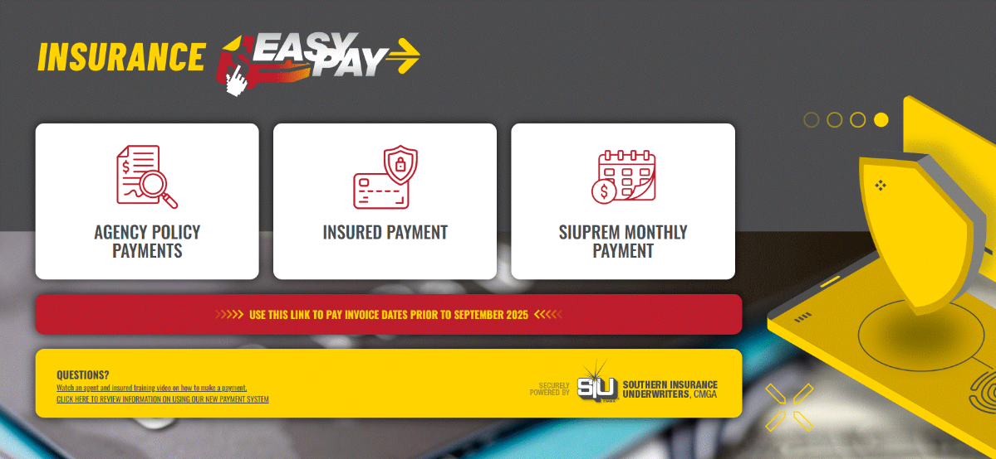
‘Agency Payment’ = pay multiple invoices at once
‘Insured Quote Payment’ = pay an invoice on behalf of the insured
Click this URL to Access Payment: https://insuranceeasypay.siuins.com/

Slide 3
Create an Account or Pay as a Guest
By Creating an account this will give you the option to save your payment method for future use
Continue as a Guest to pay an invoice/invoices

Slide 4
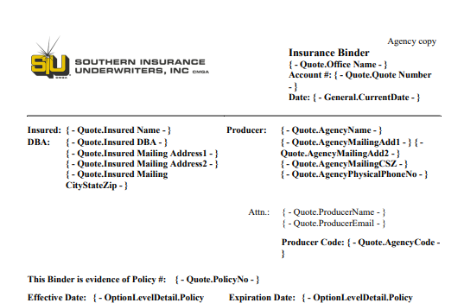
What you need:
  Agency number – Located on Binder
  Billing Zip code of agency

Slide 5
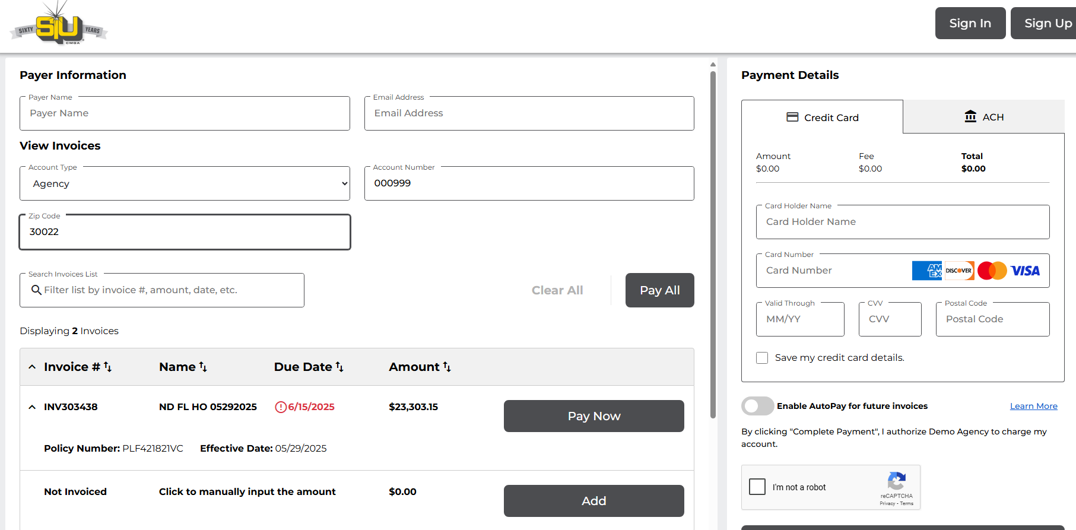
Plug in Agency Number and Billing Zip Code
Notes:
If you use the wrong zip code, it will say "No invoices found"
Once an invoice is posted to accounting , it will show up on Epay

Slide 6
Select ‘Pay Now’ next to the invoice you want to pay or select ‘Pay All” if you want to pay all

Slide 7
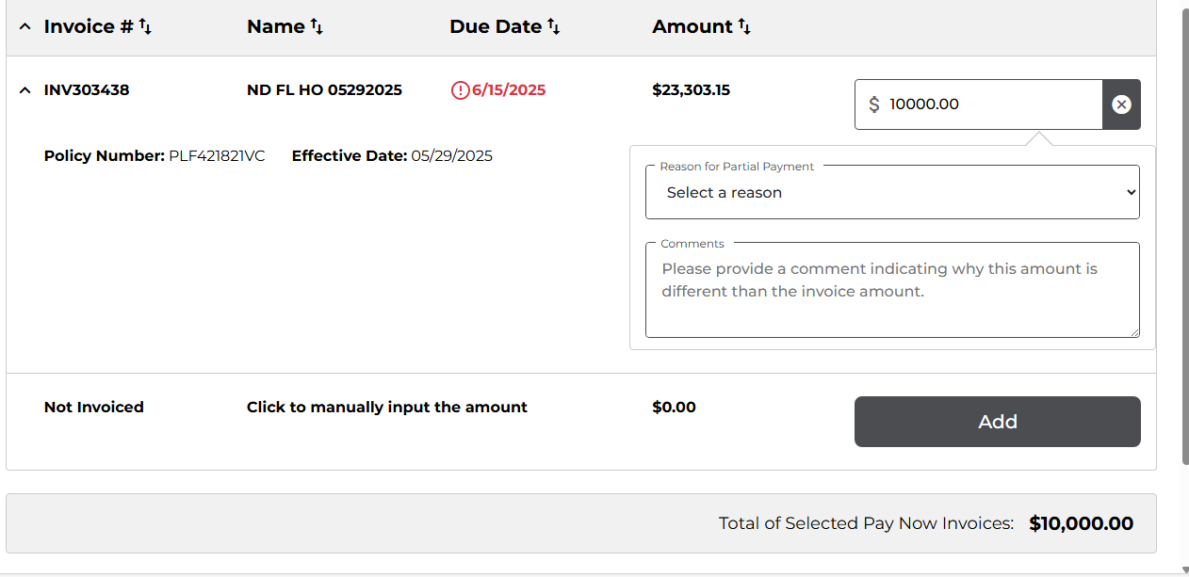
You may choose to pay a full payment or down payment. If making a down payment, please be sure to provide a reason. (ex: financing with SIUPREM) *zoomed in*

Slide 8
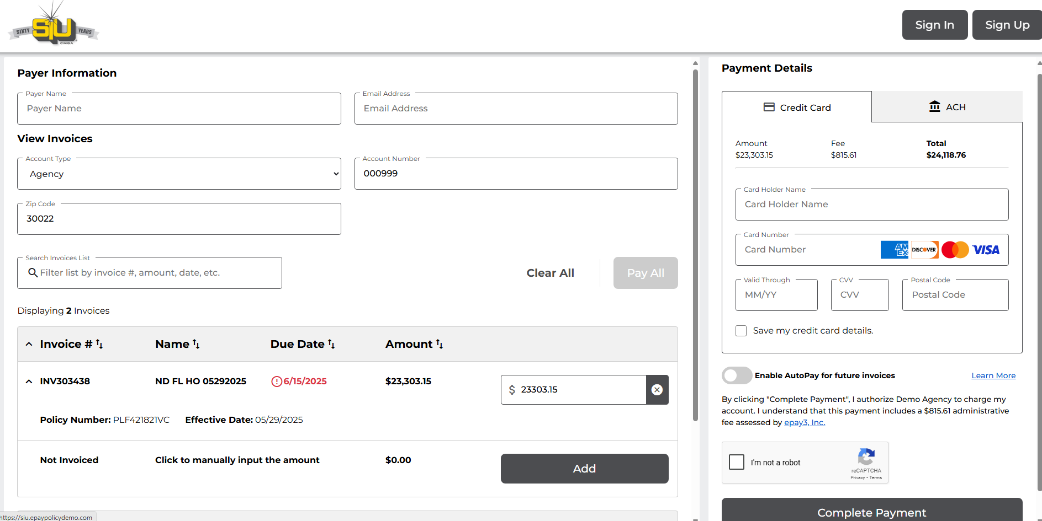
Double check the total before entering in payment info

Slide 9
Enter the payer's name and the email address where you'd like the receipt to be sent.

Slide 10
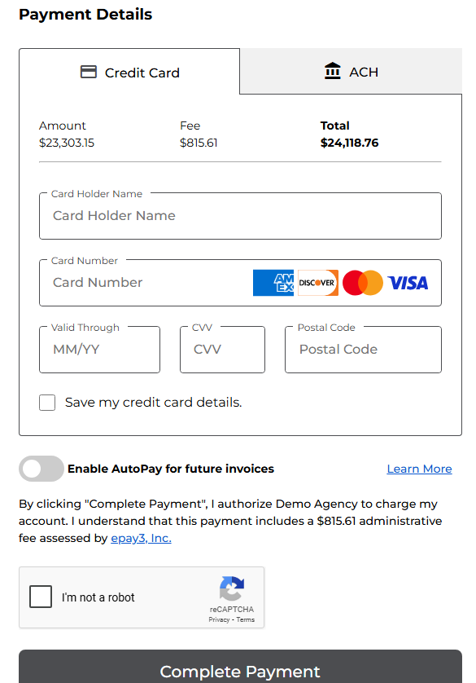
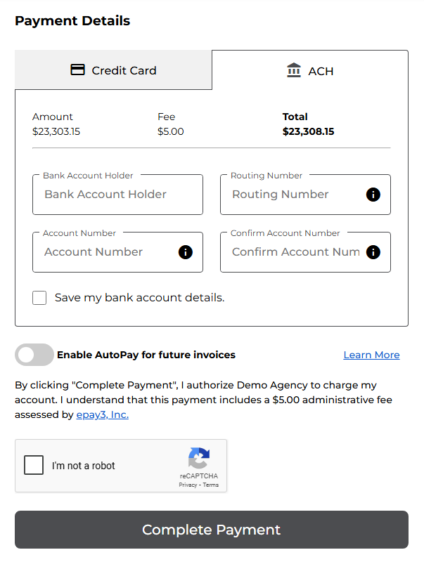
Plug in Credit card info or ACH info *zoomed in*
If you created an account, check ‘Save my credit card/bank account details’ to securely save your payment information for future use.
Check ‘I’m not a robot’ and complete the image verification.
Click ‘Complete Payment’ to finalize your transaction.

Slide 11
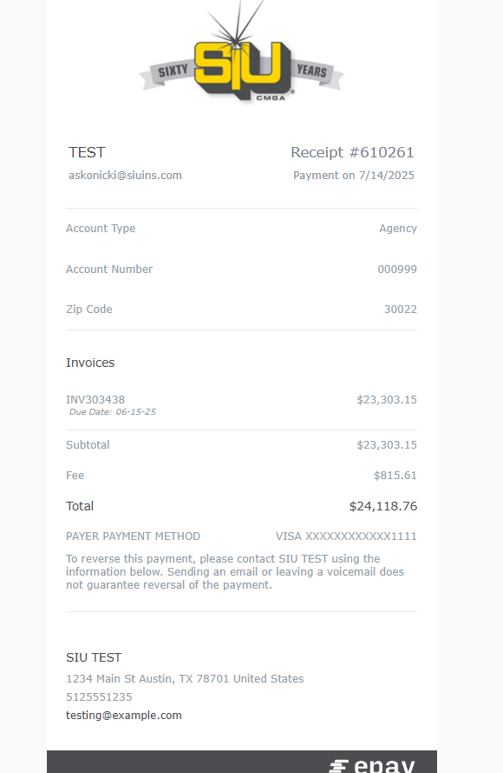
The payment confirmation screen will be display after clicking ‘Complete Payment’, and a receipt will be sent to the email address you provided.

Slide 12
Have any Questions?
Our Marketing team is ready and happy to help you anytime!
Email: marketing@siuins.com
Phone: (678) 498-4619
Live Chat: https://primary.siuins.com/Home/Login

