Slide 1

Insured Payment
Southern Insurance Underwriters New Epay Platform

Slide 2
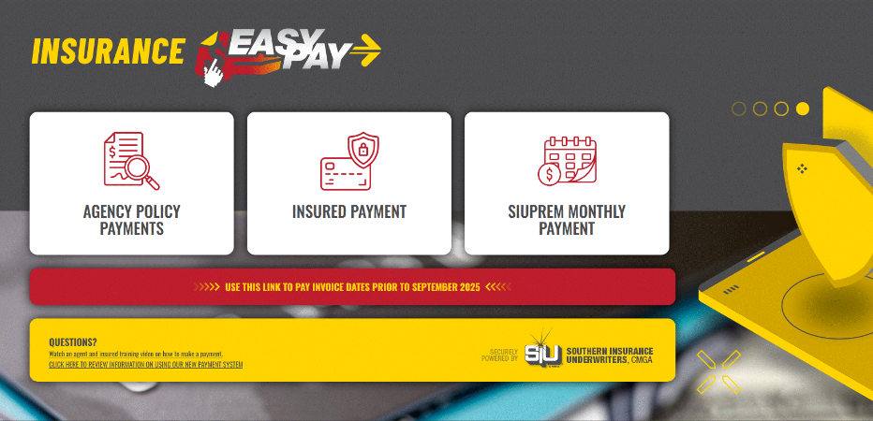
‘Insured Quote Payment’ = pay invoice in full or down payment
‘SIUPREM Monthly Payment’ = financed payments through SIUPREM
Click this URL to Access Payment: https://insuranceeasypay.siuins.com/
Notes:
Remember if you completed the SIU Direct Bill Form and sent it in with the bind request no additional online payment is needed. We will process on behalf of your customer. Once an agency bill policy has been bound and invoiced it must be paid using the agent payment button.

Slide 3
Create an Account or Pay as a Guest
By Creating an account this will give you the option to save your payment method for future use
Continue as a Guest to pay a policy in Full or a Down payment
Notes:
Account number = quote ID. This is the "SUB" number WITH the "-01" or "-02",etc.

Slide 4
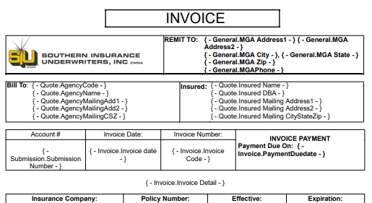
What you need:
  Account number – Located on Invoice
  Billing Zip code of insured

Slide 5
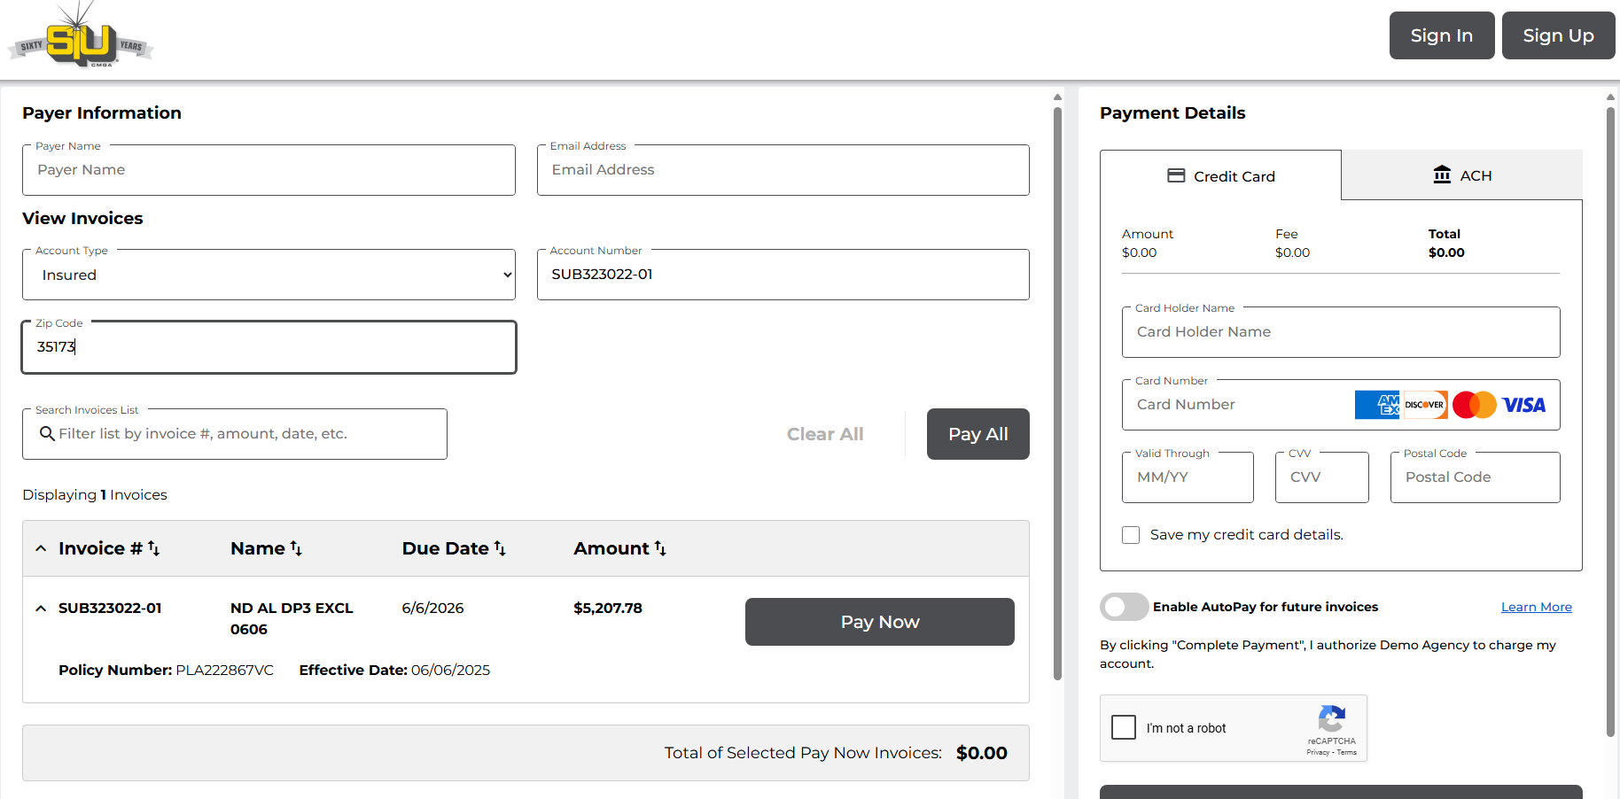
Plug in Account number and Billing Zip Code
Notes:
If you use the wrong zip code, it will say "No invoices found“
Once an invoice is posted to accounting in ALIS, it will show up on Epay

Slide 6
Select ‘Pay Now’ next to the invoice you want to pay or select ‘Pay All” if you want to pay all

Slide 7
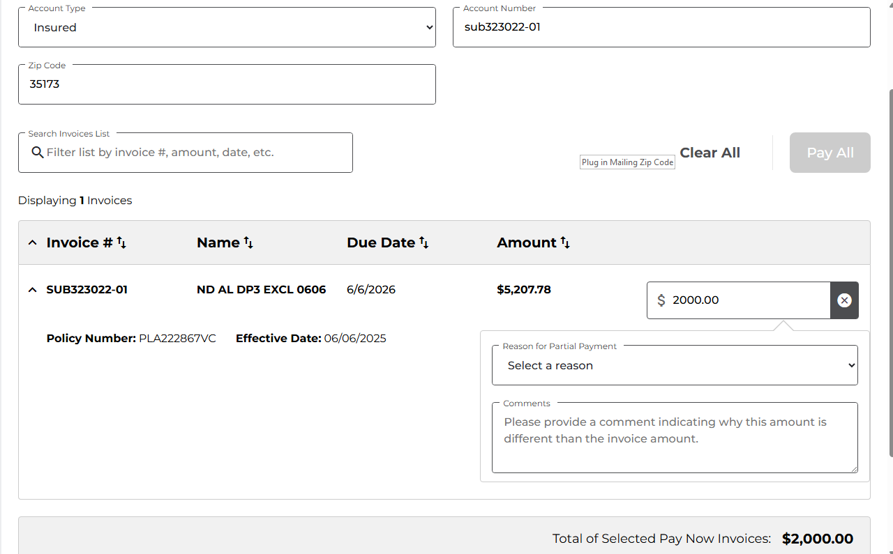
You may choose to pay a full payment or down payment. If making a down payment, please be sure to provide a reason. (ex: financing with SIUPREM) *zoomed in*

Slide 8
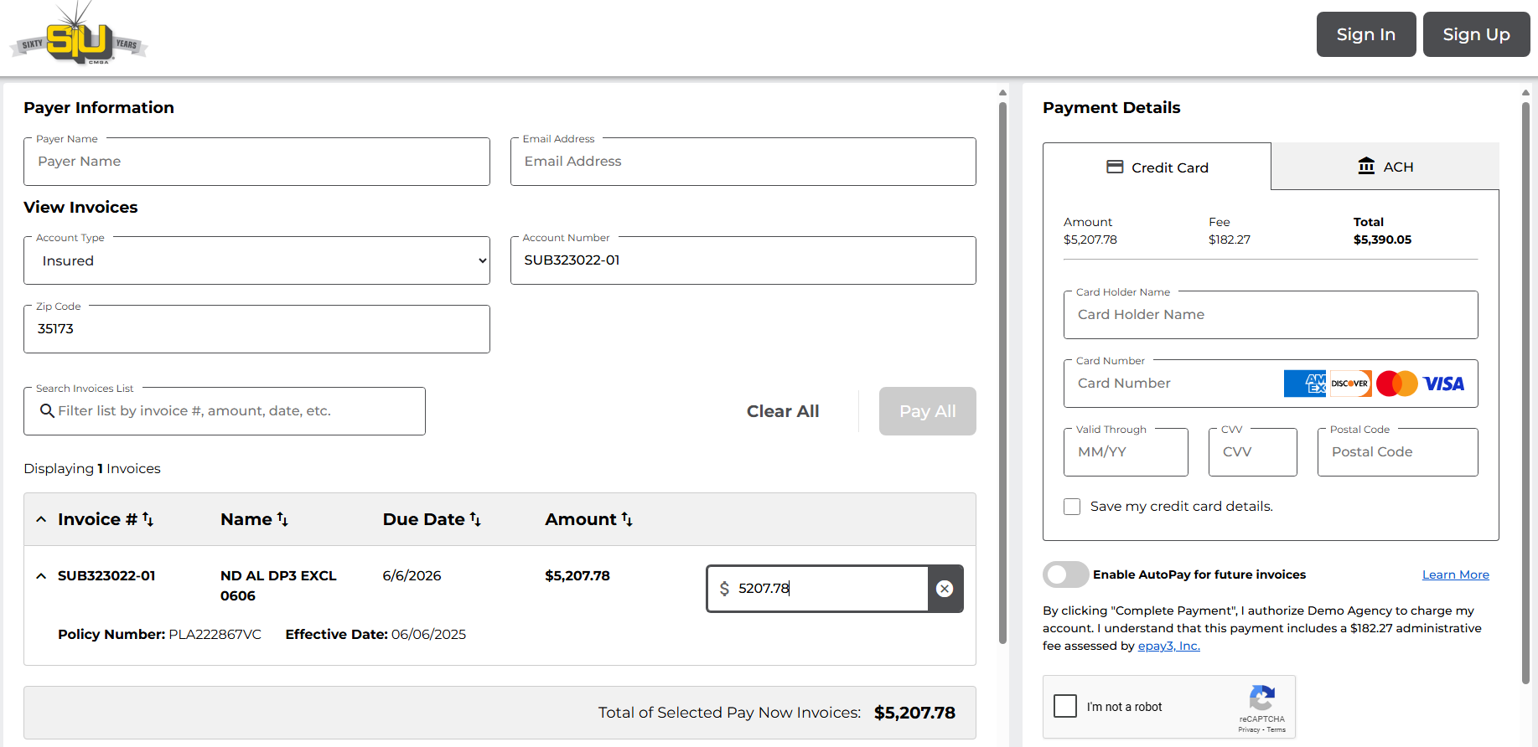
Double check the total before entering in payment info

Slide 9
Enter the payer's name and the email address where you'd like the receipt to be sent.

Slide 10
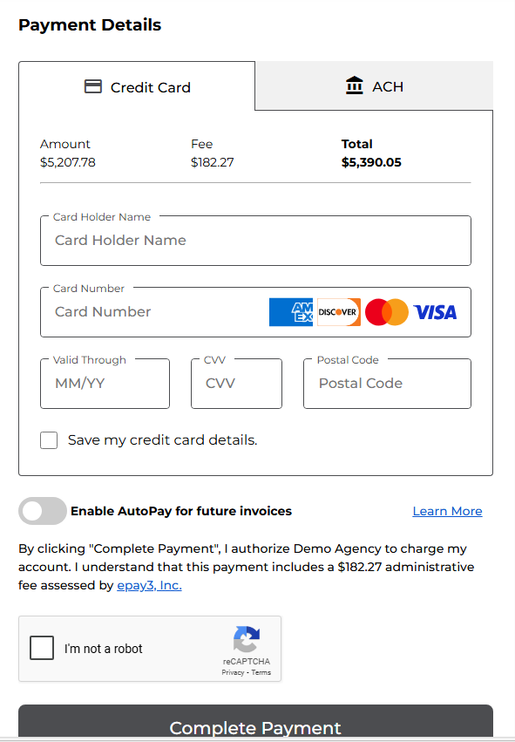
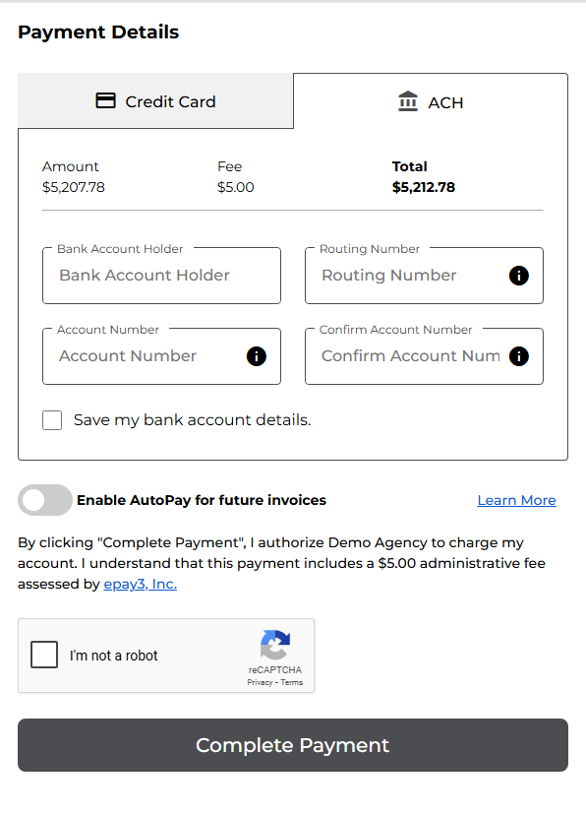
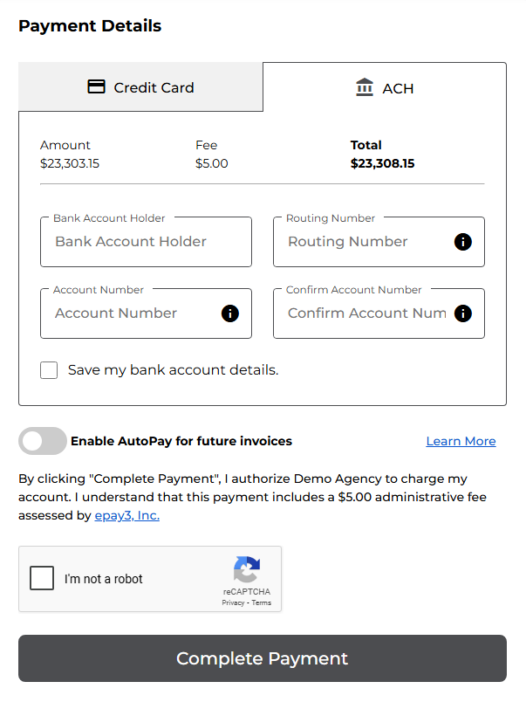
Plug in Credit card info or ACH info *zoomed in*
If you created an account, check ‘Save my credit card/bank account details’ to securely save your payment information for future use.
Check ‘I’m not a robot’ and complete the image verification.
Click ‘Complete Payment’ to finalize your transaction.

Slide 11
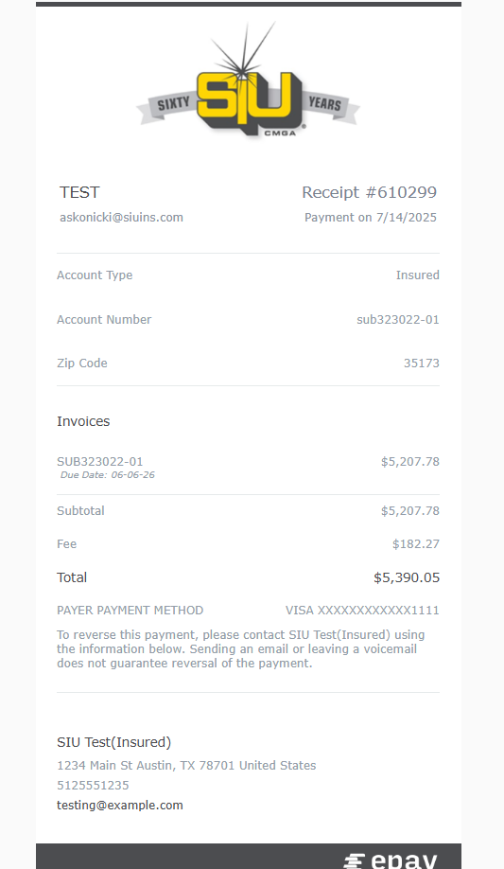
The payment confirmation screen will be display after clicking ‘Complete Payment’, and a receipt will be sent to the email address you provided.

Slide 12
Have any Questions?
Our Marketing team is ready and happy to help you anytime!
Email: marketing@siuins.com
Phone: (678) 498-4619
Live Chat: https://primary.siuins.com/Home/Login

